Slide 1


IOT BASED
Team Members
Guide
Ms. Jesna Anver
Asso. Prof.
CSE
Stephy John
Elsa Thomas
Ranjana Raju

Slide 2
Contents
Introduction
Existing Systems
Literature Survey
Analysis
Design Phase
High level design-Functional requirements
6.1 Smart room
6.2 Smart Bin
6.3 Garden/Farm

Slide 3
7. Use Case Diagram
Use Case specification with UI Designs
Database Design
Class diagram
Class Table
Implementation details-Hardware requirements and software requirements.
Screenshots
Future Works Suggested
Conclusion
References

Slide 4
INTRODUCTION
The Internet of things (IoT) is the network of physical devices, vehicles, home appliances, and other items embedded with electronics, software, sensors, actuators, and connectivity which enables these things to connect, collect and exchange data.
In this study ,we introduce IOT technology to overcome the issues faced in these fields:
Security and energy conservation.
Waste management.
Farm/garden irrigation methods.

Slide 5
Existing System
Buildtrack smart automation
Drip Irrigation
Smart Bin
Curiousfly

Slide 6
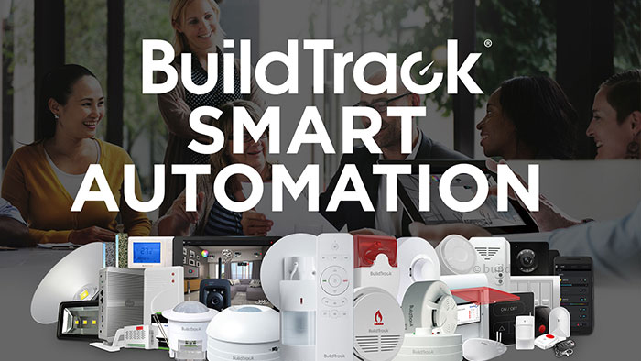

Slide 7

BuildTrack is a company working in Smart Automation and Internet of Things (IoT) solutions for Homes, Enterprises, Hotels, Hospitals and Warehouses.

Slide 8
Features
Security System like:
CCTV cameras and Video
Digital Door Lock
3. Safety and Security sensors like smoke, fire, Gas etc.
4.Buildtrack curtain/Blind control system.
5.Buildtrack panic buttons for elders.
Motion sensors for energy savings.
Enables access and control through company’s mobile applications.
Switches to control lights,fans,curtains etc.

Slide 9
Pros
Offer solutions for Energy Efficiency that enable ZERO energy wastage
It enables productive management of Residential, Commercial Buildings and Campuses.
It is more convenient to use.
Proper monitoring and security.
Offers both remote and voice enabled control.
Customization-Allows choice of both wired and wireless deployment.
User comfort is prior.

Slide 10
Cons
It does not offer any techniques for solving:-
Food waste.
Wastage of water.
Irrigation of plants/garden.
High cost.

Slide 11

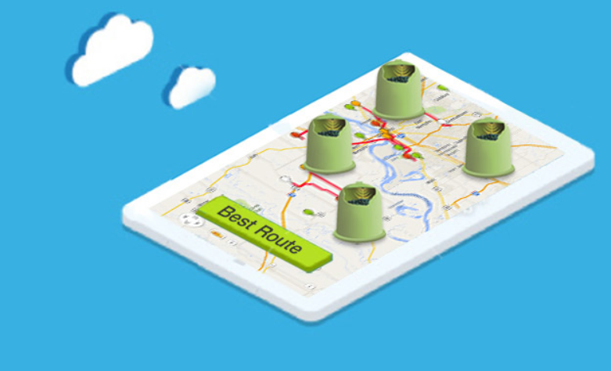

Slide 12

Intelligent Remote Monitoring Solutions for Collectors of aste anWd Recycling
Key Features
Ultrasonic fill-level, geo-location & temperature
Completely wireless with 3+ years battery life
Weighing less than 9 ounces & easily mounted to any container
Zero maintenance with a non-corrosive protective shell
Measures up to 3m in depth

Slide 13

Always know the fill-level of your containers.
Send efficient routes directly to drivers.
Eliminate over-filling and emergency call-outs.
Monitor your containers and plan optimized routes from anywhere. Smart in Live is the IoT game changer for collectors and distributors around the world.

Slide 14
Cons
This system mainly focuses the entire city.
It is a foreign waste automation company. So its facilities are not available in India.
It focuses only metropolitan cities.

Slide 15

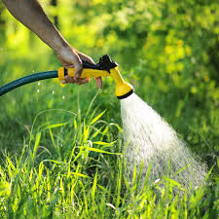
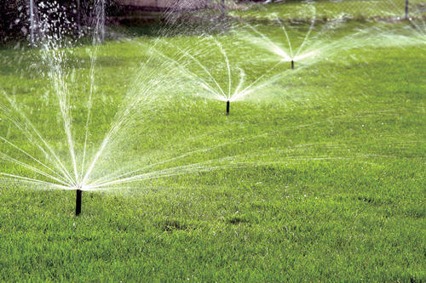
Existing Irrigation Methods

Slide 16
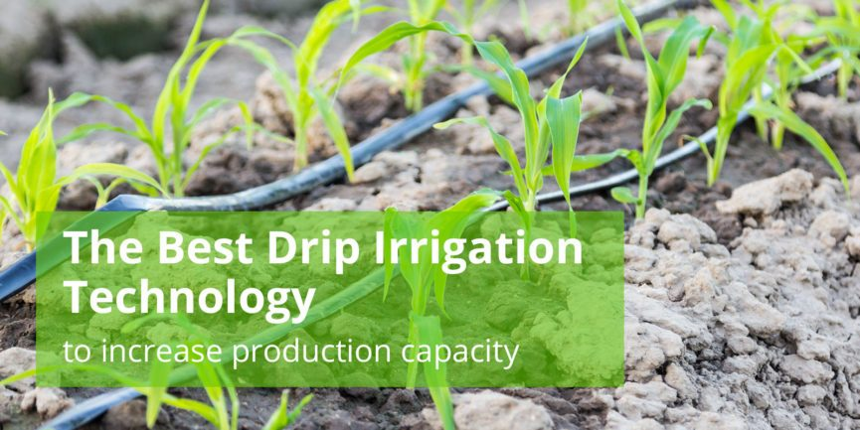

Slide 17
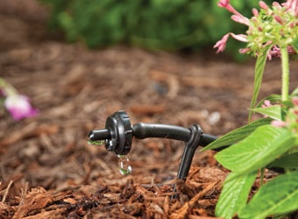
Drip irrigation is a type of micro-irrigation system that has the potential to save water and nutrients by allowing water to drip slowly to the roots of plants, either from above the soil surface or buried below the surface.
The goal is to place water directly into the root zone and minimize evaporation.

Slide 18
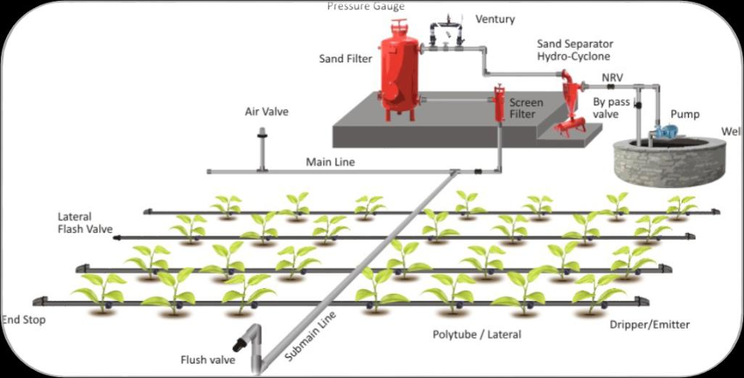
Components and features used in drip irrigation (listed in order from water source) include:
Pump or pressurized water source.
Backwash controller (Backflow prevention device).
Pressure Control Valve (pressure regulator).
Distribution lines (main larger diameter pipe, maybe secondary smaller, pipe fittings).
Hand-operated, electronic, or hydraulic control valves and safety valves.
Poly fittings and accessories (to make connections).
Emitting devices at plants (emitter or dripper, micro spray head).

Slide 19

Saves water and time.
Decreased labor costs in commercial sectors, agriculture/farming.
No water deficiency in crops.
User friendly setup.
Easy to control.
Cover whole area of the field.

Slide 20
Cons
It can be used for only specific crops as water requirement for different crops are different.
Needs manual monitoring for checking water level for different crops.
Cannot used for plant germination unless distance between drips is short.
Water application pattern must match planting pattern.
Safety
It is more suitable for large scale production.

Slide 21


Slide 22
Key Features
Curiousfly is a leader & game-changer in transforming the electrical switches with the home automation skill set.Its "smart switches" does not require any CAT cabling or home automation DB.
Curiousfly is accessed using mobile app access to home appliances, even with a normal wiring.
Together with Amazon echo & Google home, it creates wonders with voice commands to daily habits.
Provides easy integrations with gates, curtains, dimmable LED's, sprinklers & much more

Slide 23
Pros
Status check and control of appliances from anywhere.
Schedule your appliances as per your routines.
Monitor the energy consumption of your appliances. Set limit and get alerts.
Set custom scenes according to your mood for the weekend party or a movie.
Timer
Set timer for instant use of home appliances.
App Sharing
Extend app control to your family.

Slide 24
Cons
It does not offer any techniques for solving:-
Food waste.
Wastage of water.
Irrigation of plants/garden.
Complex technology
High Cost

Slide 25
ANALYSIS
In buildtrack security through CCTV near doors enable users to record and see footage for viewing only i.e. it will not stop theft or crime when it is in progress and thus allow criminals to escape.
In proposed system CCTV cameras will detect face and will lock/unlock door based on pattern matching and security alerts will also be send when needed.
Curiousfly does not offer any techniques for solving: - Food waste, water level monitoring while proposed system aims to overcome these limitations using app alert system and sensors.
Curiousfly uses more complex technologies but proposed system will not include complex technologies like Amazon echo.

Slide 26
In drip irrigation, manual monitoring is needed for checking the moister level or water level in soil and after checking have to be manually operated.
To overcome this problem we introduce an automatic irrigation system which will check the water level in soil automatically and if the soil is very dry an alert will be send.
In drip irrigation, there are no techniques for identifying the water level in the water tank when it is low. But in proposed system when low level of water is identified. Water will be automatically filled by the proposed IOT system.

Slide 27
Smart bin is a automatic waste collection service. But it is limited to metropolitan cities. In India Smart bin’s service is not available.
In the proposed system we will introduce solutions to manage this problem by implementing services similar to ‘Smart bin’.
In this study, existing products in the chosen domain were analyzed.
Design of new system will include all necessary features of existing system with needed modification. New system will be combination of all four products studied.

Slide 28
Design Phase
Problem Statement
In the recent decades urbanization has increased tremendously which lead to more commercial buildings & houses. This results in the following problems:
Wastage of electricity due to negligent use by consumers.
Inefficient and time consuming irrigation methods for garden/farm.
Improper waste management at buildings.

Slide 29
The proposed system presents an approach for smart automation using Internet of Things technology.
This project aims to give the following solutions through mobile application:
Smart Security System:
Automatic and Semi-Automatic unlocking/locking facility based on face recognition.
Alert sending facility.
Energy saving solutions:
Sensor control lighting which can be used at front door,cooridors, garage.
Monitor data generated from analog sensors (humidity and temperature).
Easy control of lights/devices through app.

Slide 30
Waste management solution:
Iot fill – level check sensors and efficient route tracking technique for the containers requiring services.
Wifi enabled Irrigation method:
Sensor based moisture level test.
Monitor data and activate pump through our ‘Smart Room’ app.
Automatic water checking and filling.
Alert receiving.

Slide 31
Aim and Objectives
This project addresses an IoT software-based approach in the field of Home Automation. Common features include :
Measuring home conditions.
Controlling home appliances.
Controlling home access.
Farm and garden irrigation methods.
Automatic water checking and filling.
Smart waste management solutions.
Benefits
Maximize the safety and security of home and property.
User comfort and convenience.
Easy monitoring.

Slide 32
HIGH LEVEL DESIGN
SMART ROOM
CLOUD(Ubidots,Thingspeak)
MOBILE APPLICATION
SMART BIN
GARDEN/FARM
IOT SENSORS

Slide 33
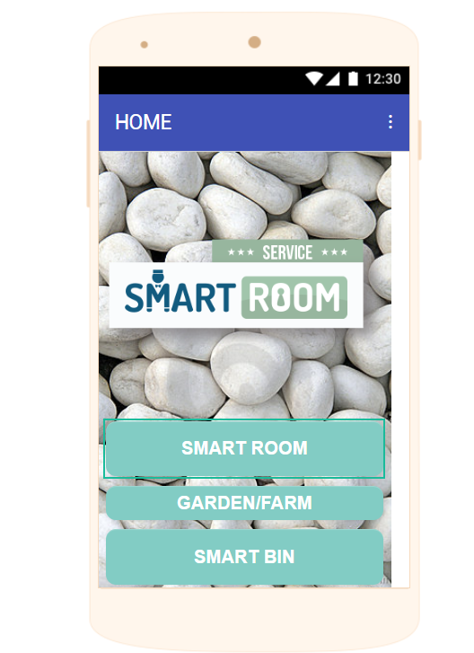

Slide 34
Functional requirements

Slide 35
FR1
TITLE: Login
DESC: Allows user to login and access the services of the mobile application.
FR2
TITLE: Door lock/unlock
DESC: Allows user to lock and unlock door.

Slide 36
FR3
TITLE: Send Alert
DESC: Allows user to send alert message to concerned authority.
FR4
TITLE: Bulb on/off
DESC: Allows user to switch on and off bulb.

Slide 37
FR5
TITLE: Pump on/off
DESC: Allows user to switch on pump for watering plants based on moisture content of soil or to off the pump when not needed.
FR6
TITLE: Data Value Display Box
DESC: This label box will display data values from different sensors (here needed for soil moisture level, water level in tank and waste level in waste container).

Slide 38
FR7
TITLE: Emergency Notification box
DESC: User will receive emergency message when needed.
FR8
TITLE: Camera face Pattern Matching
DESC: When face pattern matches door will automatically open. When mismatch occurs user will be notified through SMS and via email about the new face recognized.
FR9
TITLE: Automatic lighting
DESC: When motion detected system will automatically switch on light. During night light will automatically switch on.

Slide 39
SMART ROOM

Slide 40
Functionality
User
A user has the following features through a mobile application in which he/she:
1.Can login and register through sign in and sign up buttons.
2. Can turn on or off bulbs and monitor the state of the bulbs.
3. Can lock and unlock doors through servo motors and monitor if the doors are locked or unlocked.

Slide 41
4. Is notified through email if the door is being opened by a new person.
5. Is notified of who tried to open the door as the camera captures the face image and sends it to user via email.
6.Can view Temperature and humidity values of room in app.
Police
1.Security alert can be send to police if an intruder is identified.

Slide 42
SMART BIN

Slide 43
Functionality
User
A user has the following features through a mobile application:
1.Can view waste level with a notification of present condition.
2. Alert can be send to municipality.
Municipality
1.Will be informed about the waste level.
2. Can collect waste before it fills.

Slide 44
GARDEN/FARM
Sub modules:
GARDEN/FARM
WATER TANK

Slide 45
Functionality
User
1.Can view moisture level in soil.
2.Can see water level of tank .
3.User is notified about automatic activation of motor to fill tank .
4.Garden or farm watering can be done with the help of pump on/off buttons based on moisture level of soil.
5.Alerts will be received in app.

Slide 46
Use Case Diagram
This use case describes various actions and role performed by different actors (User, Police, IOT sensors, Municipality) during different events in the proposed IOT system.

Slide 47
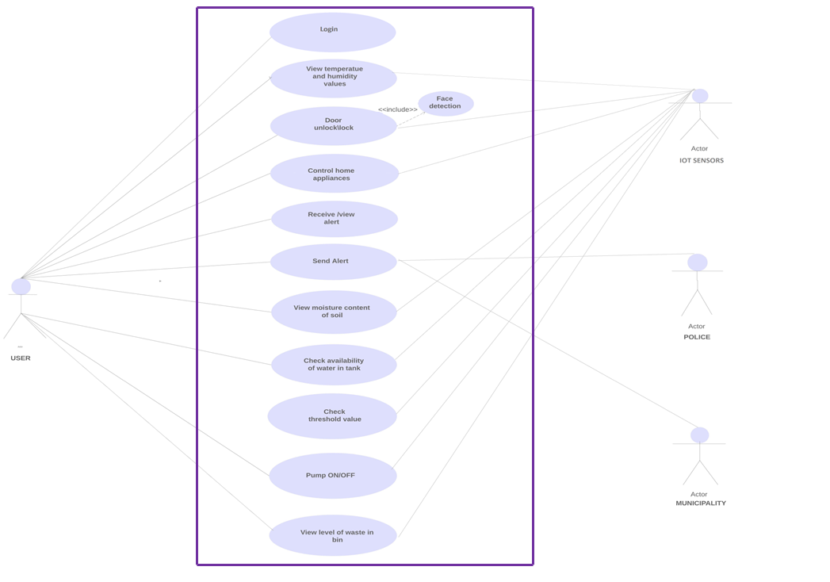

Slide 48
Use Case Specification

Slide 49
Use case name: Login
Description: Allows user to login and access the services of the mobile application.
Actor: User
Precondition
User needs a registered pin number .
Post condition
Registered user will be directed to home page.

Slide 50
Basic flow:
1. User enters his/her user name.
2. User enters his/her password
3. Click sign in button
4.Password and user id will be verified.
5.Click sign up for new user registration.
6.User enters their user name and email id.
7.Enter valid unique password key.
8.New user can access the service.
Alternate flow
1.An incorrect combination of user name and password result in the user being redirected to the login page with an error message “an incorrect user name or password have been entered”.

Slide 51
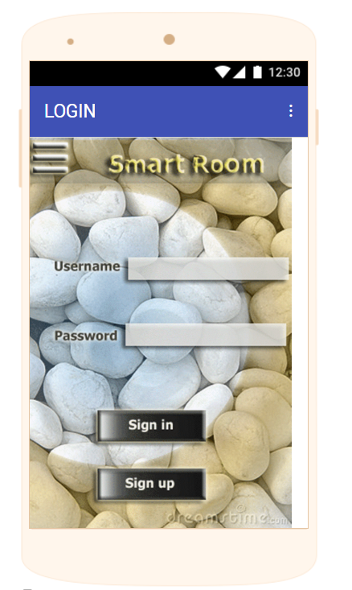
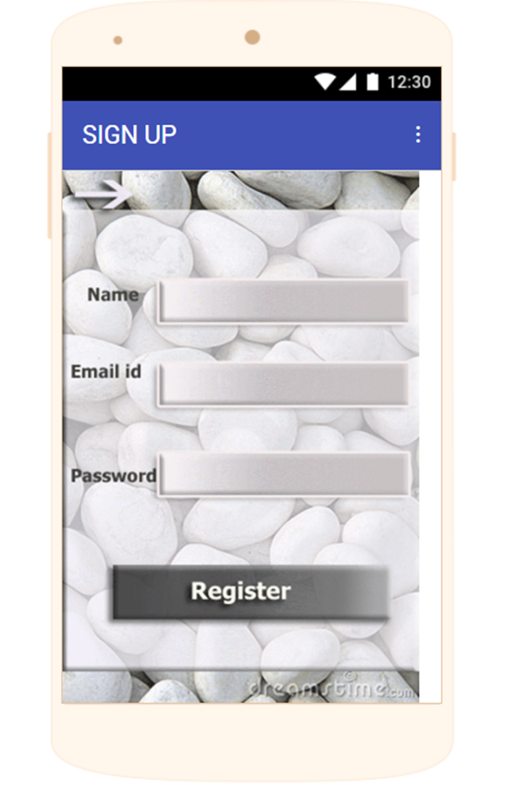

Slide 52
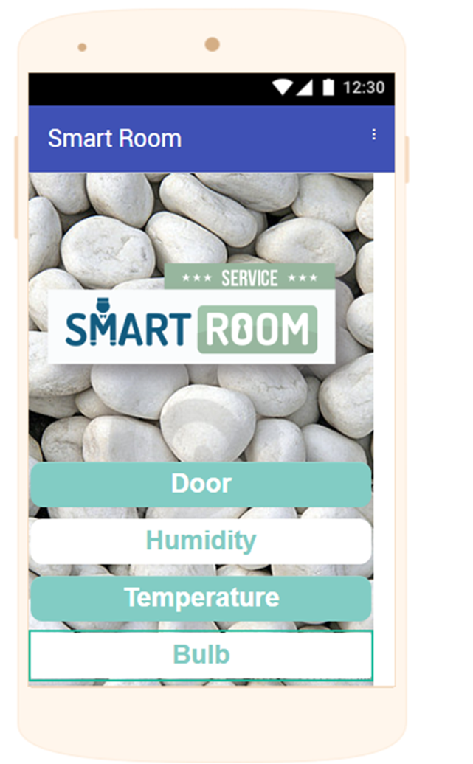

Slide 53
Use case name: Control home appliances
Use Case Description: Allows user to control home appliances like: fan, light from mobile app. Based on the motion detected and intensity of light automatic lighting is provided( by IOT sensors).
Actors:
User, IOT sensors
Precondition
A fully functioning automation system has been successfully installed and powered on.
Post condition
Data values from sensors will be displayed in the app. Easy and fully automated system as per user need is achieved.

Slide 54
Basic flow:
1.During daytime lights will be switched off.
2.During night it will be switched on by IOT sensor.
3.Motion will be detected and lights will automatically switched on by sensor.
4.User can click ‘bulb on’ when needed.
5.User can click ‘bulb off’ when lighting not needed.

Slide 55
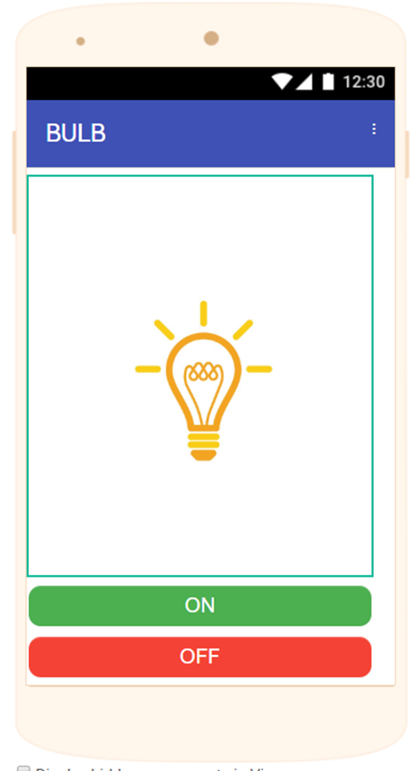

Slide 56
Use case name: View temperature and humidity values
Use Case Description: Allows user to view temperature and humidity inside a room.
Actors:
User, IOT sensors
Precondition
A fully functioning automation system has been successfully installed and powered on.
Post condition
Data values from sensors will be displayed in the app. Easy and fully automated system as per user need is achieved.

Slide 57
Basic flow:
1.Temperature values from sensors will be displayed.
2.Humidity values from sensors will be displayed.
3.User can view values in display.
4.User can send alert to concerned person when values crosses the desired level.

Slide 58
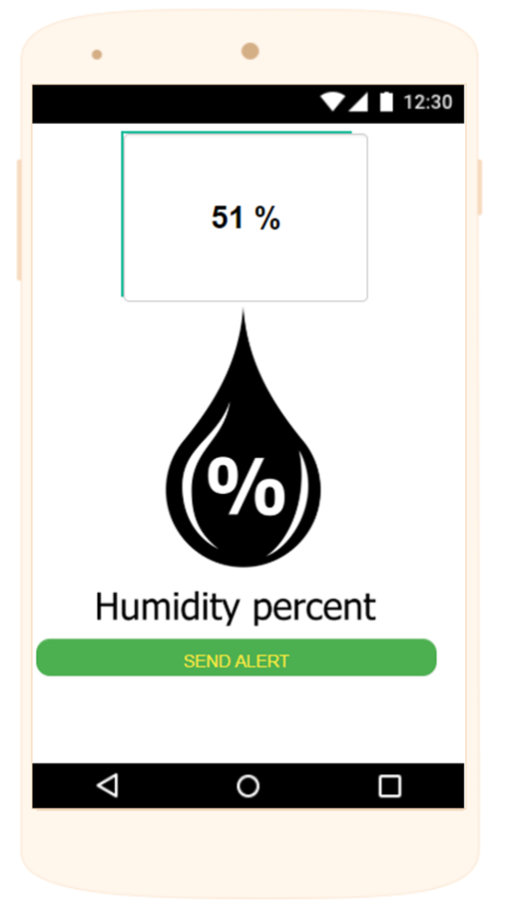
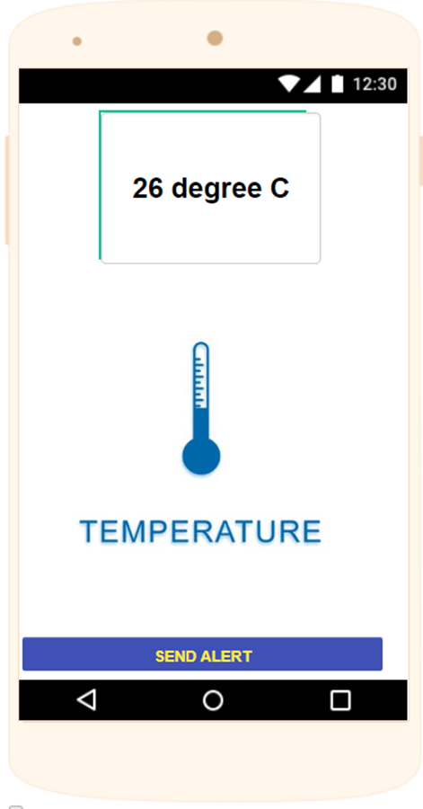

Slide 59
Use case name: Door lock /unlock
Use case Description: Ensures security to user’s home through face recognition technology. Based on recognized face automatic door lock/unlock will be performed.
Actors: User, IOT sensors
Pre condition: A fully functioning automatic face pattern matching system through camera has been successfully installed and powered on.
Post conditions: Door will open if face recognized match.

Slide 60
Basic flow:
When a new person or user tries to open the door, security system activates with help of face recognition technology.
If face matches then door opens automatically.
User is notified of who tried to open the door as the camera captures the face image and sends it to user via email.
Alternate flow:
If new person is acquaintance, user can unlock the door through app.

Slide 61
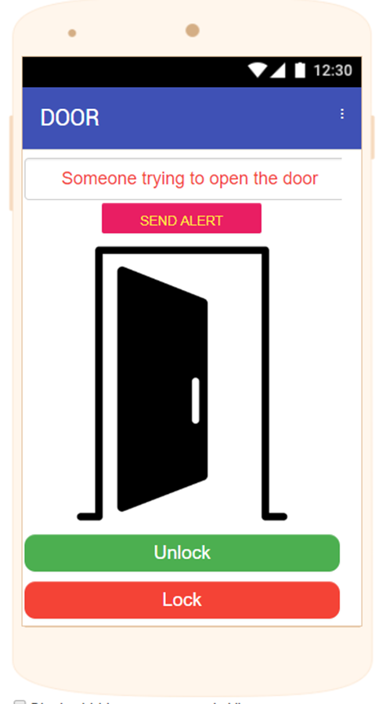

Slide 62
Use case name: View level of waste in bin
Use case Description:
The proposed IOT system consist of a sensor. This sensor is set with a limit. When waste crosses the set level automatic message will be send to user. So that user can send alert to municipality .
Actors:
User
Municipality
IOT Sensors
Pre conditions:
A fully functioning automatic system has been successfully installed and powered on.

Slide 63
Post condition: Data values from sensors with current status of waste will be displayed in app.
Basic Flow
1.User can dump waste in smart bin.
2.Height of waste will be displayed in app. 2.Status(full) will be displayed when waste crosses the limit set. 3.Status(empty) will be displayed when no waste or level of waste below the level set.

Slide 64
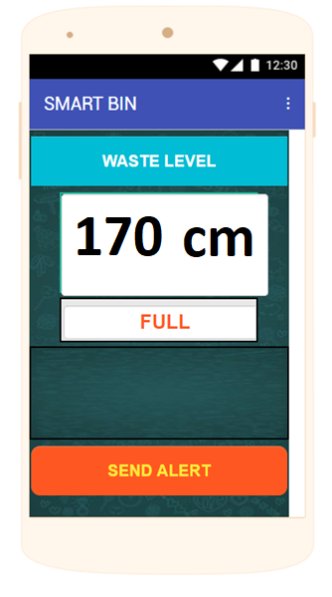

Slide 65
Use case name: Send Alert and Receive/view Alert
Description: When system detects an emergency sends data values and present status from different sensors. User can send alert to the correct authority (municipality and police) through app.
Actor: User, Municipality, Police, IOT sensors
Preconditions: System and its sensors are monitoring front door and waste bin.

Slide 66
Post conditions: User has notified the correct authority.
Basic flow:
When the system(IOT sensors) detects emergency it will send data to user.
The mobile application allows user to send alert message to municipality if needed.
The system notifies municipality location of container where the waste needs to be collected.
System(IOT sensors) will send alert SMS and photo of new person near front door to user.
App allows user to send alert to police.

Slide 67
Use case name: View moisture content of soil and pump on/off
Use case description: Moisture level of soil will be send from sensors with present condition of soil. Based on which user can pump water through buttons in app.
Pre conditions:
A fully functioning Plant Watering System has been successfully installed and powered on.

Slide 68
Post conditions:
Data values from sensors with current status of soil will be displayed in app.
Basic Flow 1.Sensors will check the moisture content in soil. 2.Moisture level value will be displayed in the app. 3.Status of soil moisture condition(dry/wet) will be displayed in app. 4. User can pump on/off based on soil conditions. 5.Water will flow through pipes.

Slide 69
Use case name: Check availability of water in the tank
Use case description: An automatic water storing using sensor .
Pre condition: A fully water storing System has been successfully installed and powered on.
Post conditions: Water will automatically fill in the storage tank.
Basic flow:
1.Water level will be detected by sensors
2.Value will be displayed with present status of water tank.
3.System will automatically fill tank with water.

Slide 70
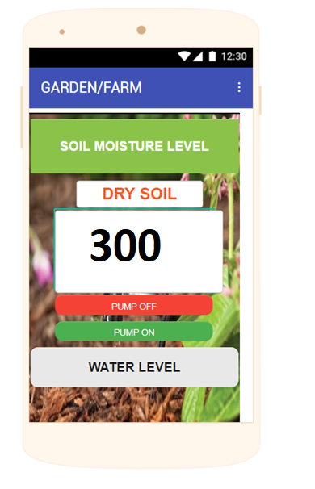
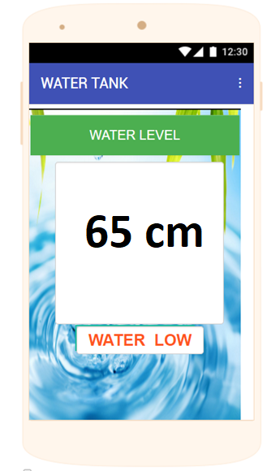

Slide 71
Database Design

Slide 72
User
# | Column Name | Type
1 | User_name | varchar(50)
3 | Password | varchar(50)
4 | Email | varchar(50)
Owner
# | Column Name | Type
1 | User_name | Varchar(50)
2 | Password | Varchar(50)

Slide 73
Class Diagram

Slide 74
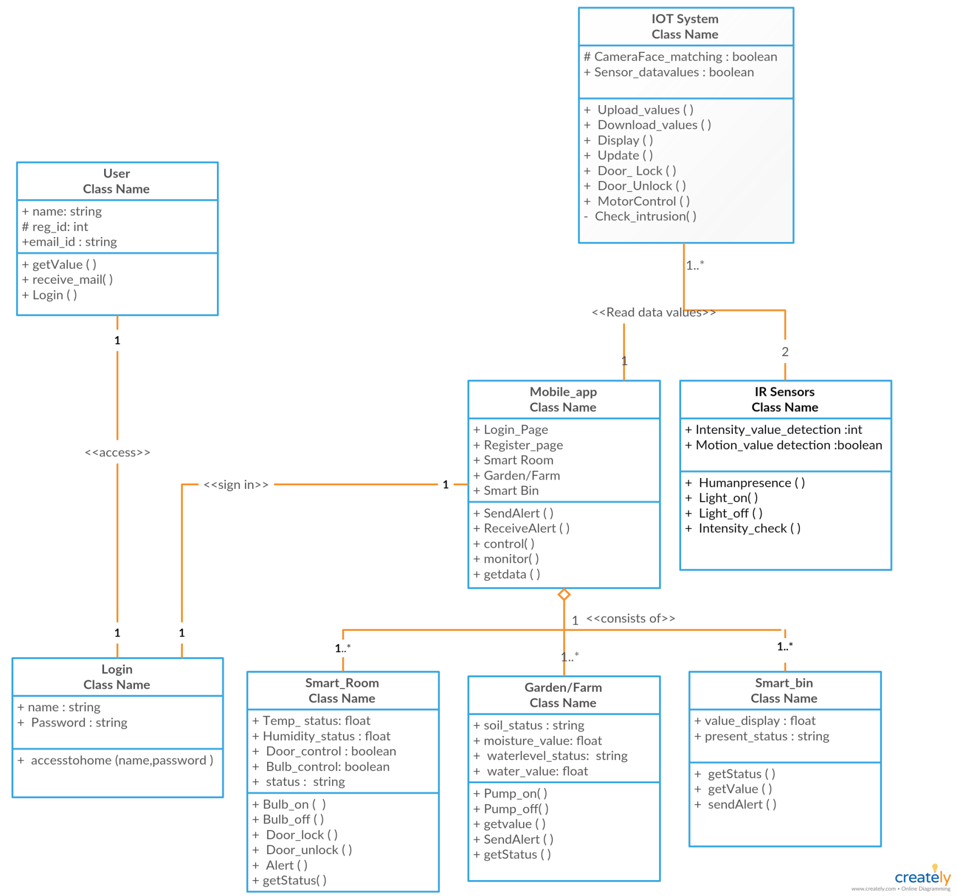

Slide 75
Class Table

Slide 76
 | Class | Purpose
1 | Iot system | It consists of face recognition based locking system and all sensors that uploads data values to cloud, so that it can be received in Mobile_app.
2 | IR sensors | It provides automatic lighting facility.
3 | Mobile_app | All data values are received with present conditions. Switch control and monitoring are possible.

Slide 77
 | Class | Purpose
4 | User | User can access the application to view, control and monitor the entire system.
5 | Login | A login is to ensure security.
6 | Smart_Room | It allows to view status of room, send alert control appliances and door lock/unlock.

Slide 78
 | Class | Purpose
7 | Garden/Farm | User can water garden/farm through pump on/off. It allows to check and monitor soil condition and water storage.
8 | Smart Bin | It allows user to check waste level in containers and he can send alert to municipality based on the present status.

Slide 79
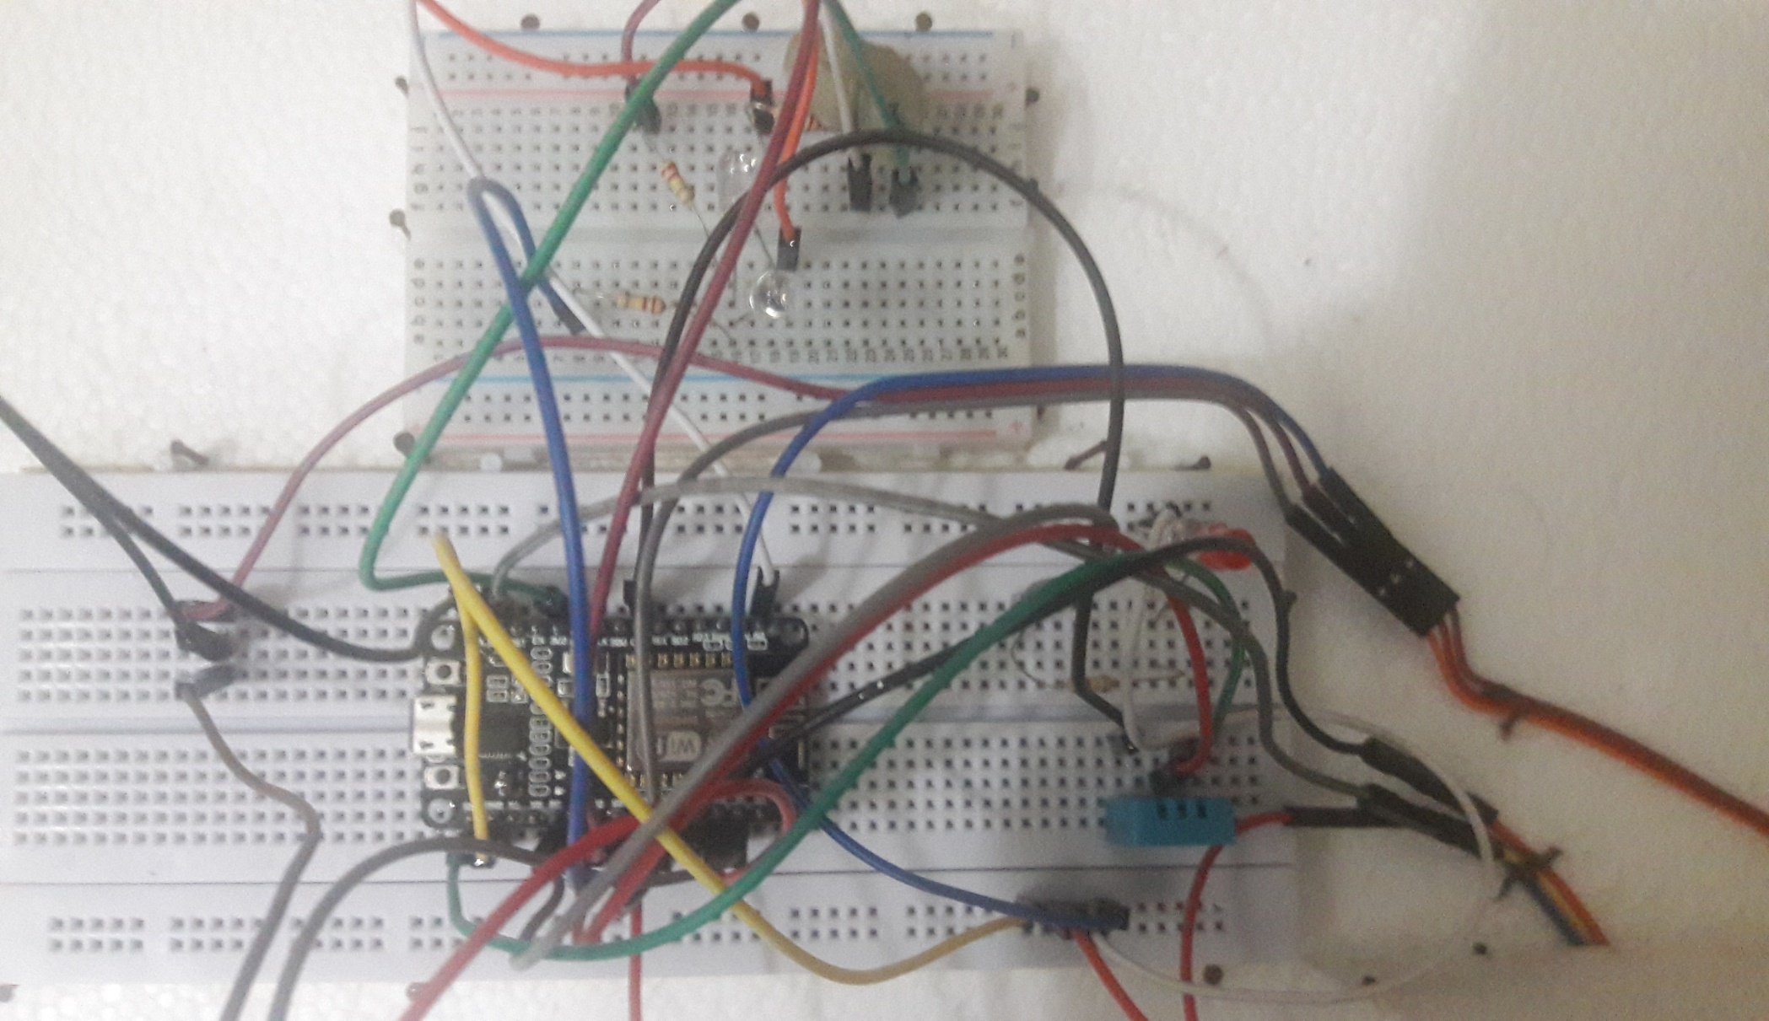
Screenshots

Slide 80
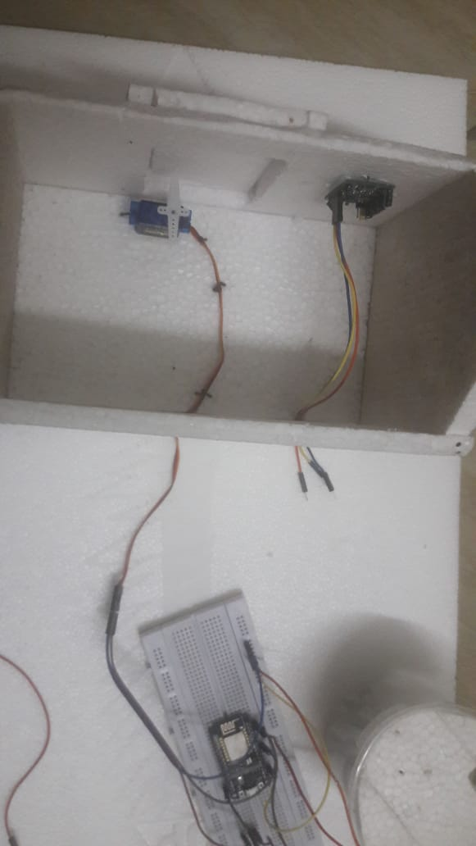
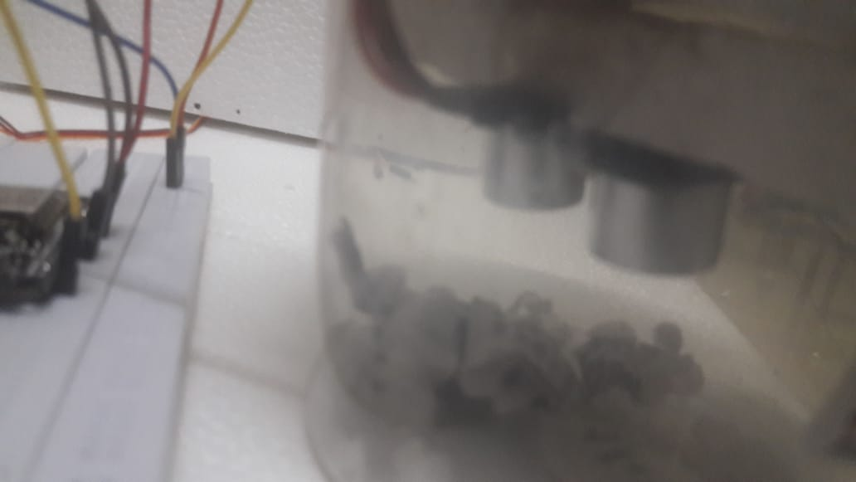
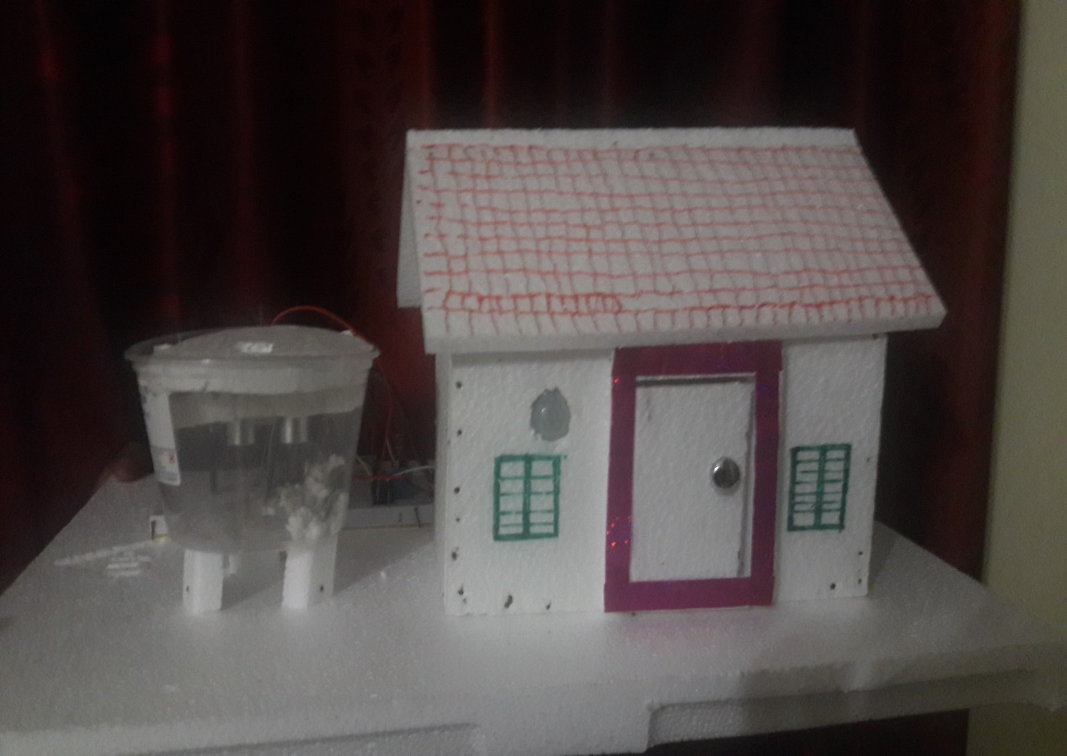

Slide 81
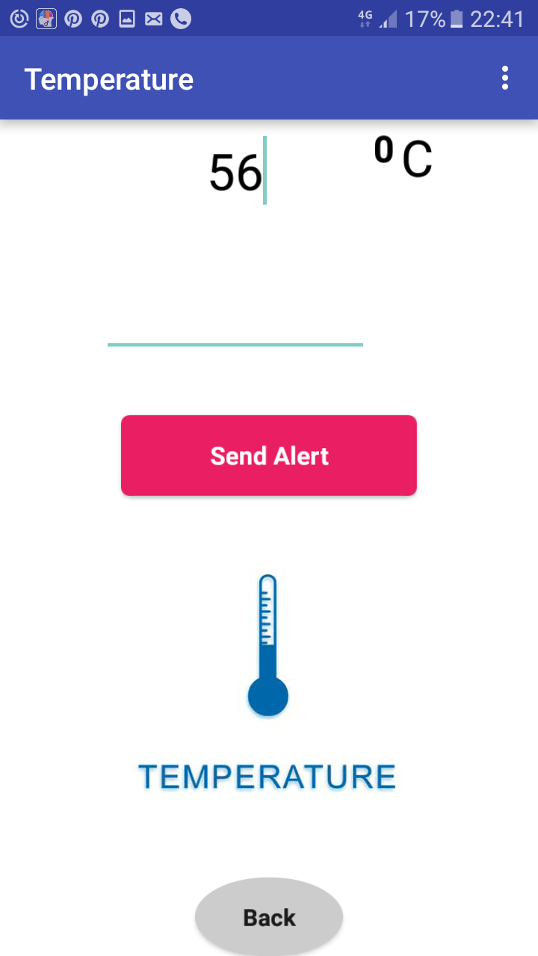
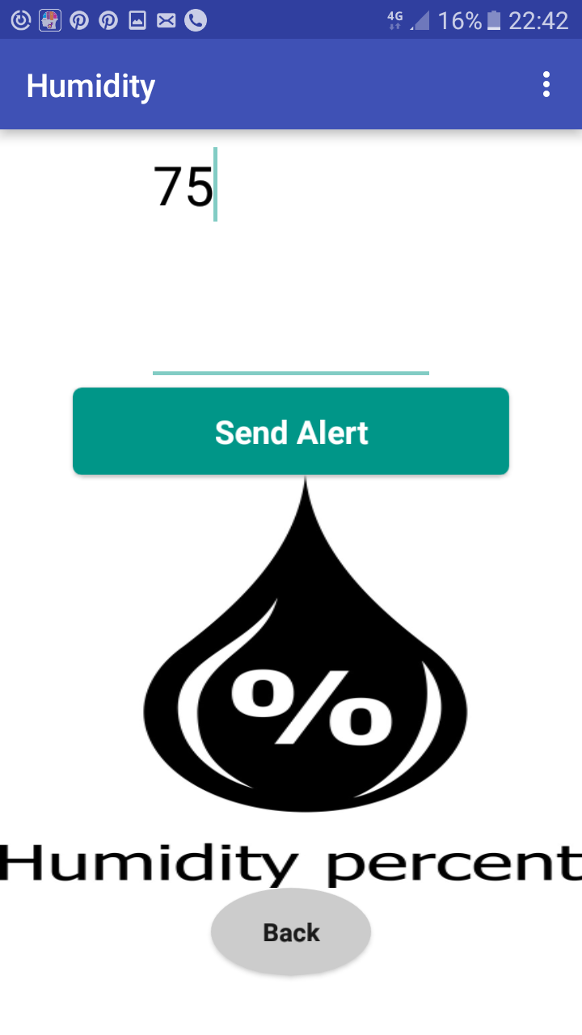

Slide 82
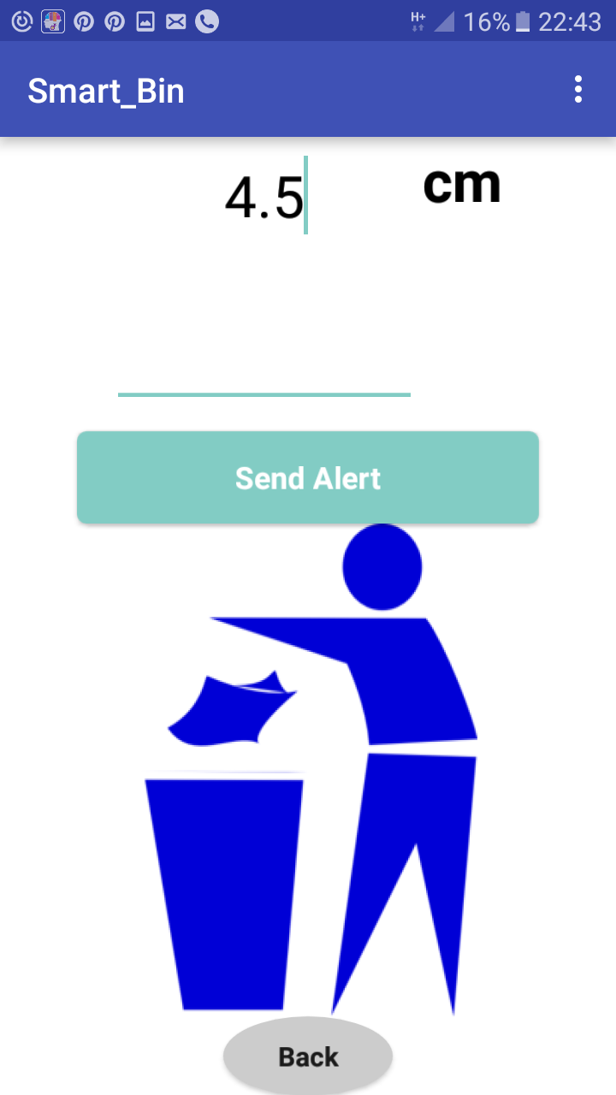

Slide 83
IMPLEMENTATION AND PRESENTATION OF DATA
Hardware Requirements
Core i3 and above
Jumper wires
Breadboard
Nodemsu ESP8266 microcontroller chip
8GB DDR4-2400 SDRAM
Servo SG 90
Ultrasonic sensor HC-SR04
PIR Motion sensor (Hc-Sr501)
Ldr
USB cable wire

Slide 84
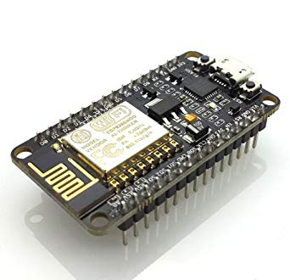
Microcontroller chip: Nodemcu ESP8266
The latest version of the board (V1.0) has the following specifications and features:
Wi-Fi Module – ESP-12E module similar to ESP-12 module but with 6 extra GPIOs.
USB – micro USB port for power, programming and debugging.
Headers – 2x 2.54mm 15-pin header with access to GPIOs, SPI, UART, ADC, and power pins.
Price:Rs 450

Slide 85
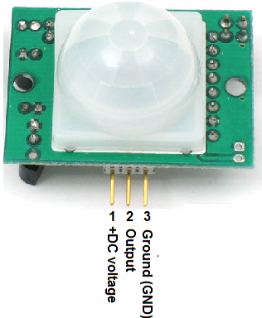
PIR Motion Detector
PIR sensor detects a human being moving around within approximately 10m from the sensor. This is an average value, as the actual detection range is between 5m and 12m.
Price: Rs 160
Specifications:
Model | PIR41
Dimensions (Sensor) | 45mmØ
Dimensions (Module) | 60 x 60mmØ
Weight | 100g

Slide 86
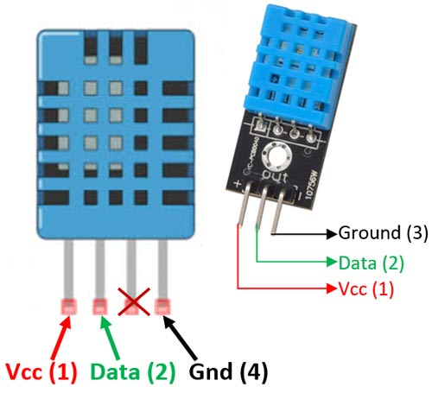
DHT11 (temp & humidity) Sensor
The DHT11 is a basic digital temperature and
humidity sensor.
Price:Rs 197
PCB size | 22.0mm X 20.5mm X 1.6mm
Working voltage | 3.3 or 5V DC
Operating voltage | 3.3 or 5V DC
Measurement range | 20-95%RH；0-50℃
Resolution | 8bit（temperature），8bit（humidity）

Slide 87
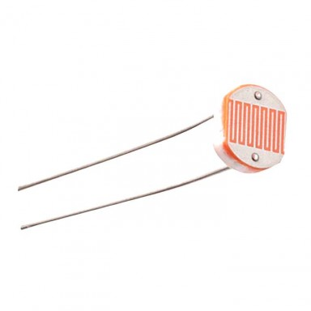
LDR(IR sensor)
A photo resistor (or light-dependent resistor, LDR, or photo-conductive cell) is a light-controlled variable resistor.
Max voltage @ 0 lux | 200V
Peak wavelength | 600nm
Min. resistance @ 10lux | 1.8kΩ
Max. resistance @ 10lux | 4.5kΩ

Slide 88
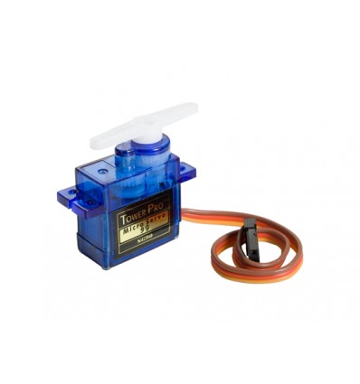
Servo SG90
Tiny and lightweight with high output power.
Servo can rotate approximately 180 degrees (90 in each direction), and works just like the standard kinds but smaller.
Can be used with any servo code, hardware or library to control it.
Operating Voltage is +5V.
Torque: 2.5kg/cm.
Operating speed is 0.1s/60°
Gear Type: Plastic. Rotation: 0°-180°.
Weight of motor: 9gm.Package includes gear horns and screws.
Price:Rs 276

Slide 89
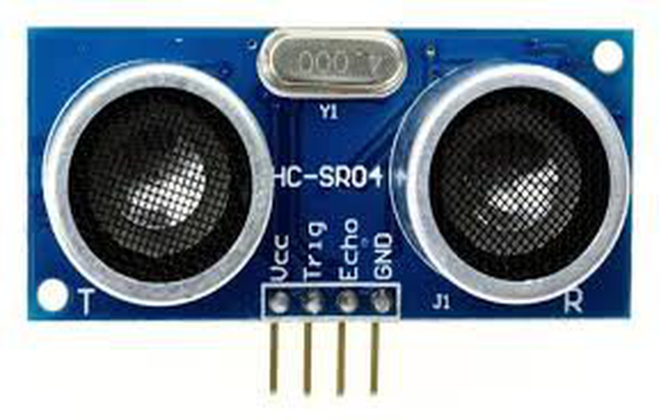
HC-SR04 Ultrasonic Module
It emits an ultrasound at 40 000 Hz which travels through the air and if there is an object or obstacle on its path It will bounce back to the module.
Considering the travel time and the speed of the sound you can calculate the distance.
The HC-SR04 Ultrasonic Module has 4 pins, Ground, VCC, Trig and Echo.
Price:Rs 194

Slide 90
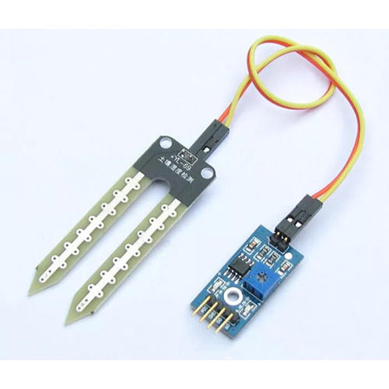
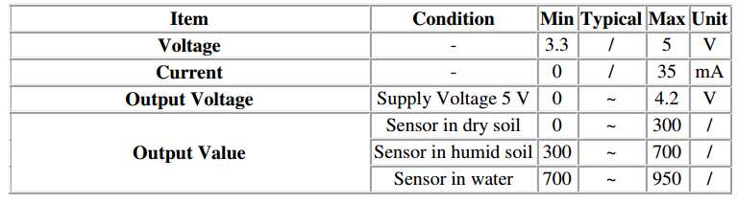
Soil Moisture Sensor
A soil moisture sensor measures the quantity of water contained in a material, such as soil on a volumetric or gravimetric basis.
The Soil Moisture Sensor uses capacitance to measure dielectric permittivity of the surrounding medium.

Slide 91
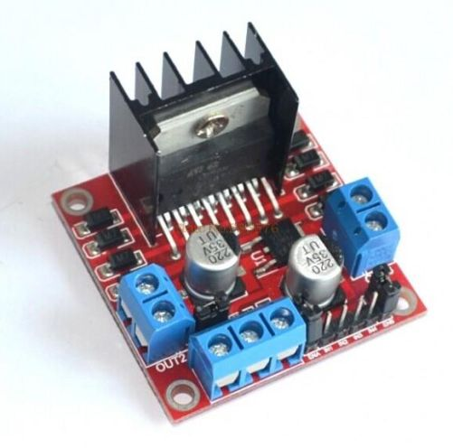
L298N Motor Driver
The L298N Motor Driver Module is a high voltage Dual H-Bridge manufactured by ST company. It is designed to accept standard TTL voltage levels. H-bridge drivers are used to drive inductive loads that requires forward and reverse function with speed control such as DC Motors, and Stepper Motors.
Price:Rs 244
Motor driver: | L298N
Maximum operating voltage: | 46 V
Peak output current per channel: | 2 A
Minimum logic voltage: | 4.5 V
Maximum logic voltage: | 7 V

Slide 92
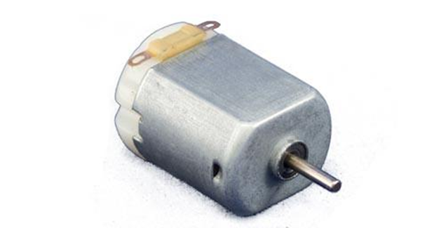
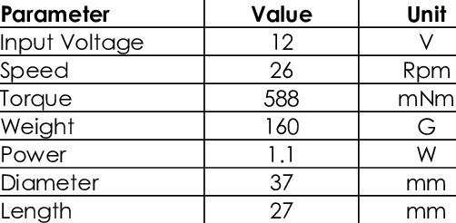
DC motor
A DC motor is any of a class of rotary electrical machines that converts direct current electrical energy into mechanical energy. The most common types rely on the forces produced by magnetic fields.
Price:Rs 115

Slide 93
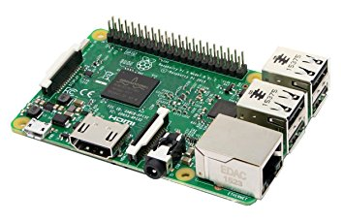
Raspberry Pi3
Broadcom BCM2837.
CPU: 4× ARM Cortex-A53, 1.2GHz.
GPU: Broadcom Video Core IV.
RAM: 1GB LPDDR2 (900 MHz)
Networking: 10/100 Ethernet, 2.4GHz 802.11n wireless.
Storage: micro SD.
GPIO: 40-pin header, populated.
Price:Rs2,996

Slide 94
Software Requirements
Windows 10 OS
Arduino IDE version:1.8.4
Libraries
Thingspeak.com
Thunkable

Slide 95
Arduino IDE version:1.8.4:
Arduino consists of both a physical programmable circuit board (often referred to as a microcontroller) and a piece of software, or IDE (Integrated Development Environment) that runs on your computer, used to write and upload computer code to the physical board
Libraries for arduino:
Desc: Libraries for DHT11, thingspeak.com and ubidots are needed.

Slide 96
Thunkable
App Inventor for Android is an open-source web application originally provided by Google, and now maintained by the Massachusetts Institute of Technology (MIT).
It allows newcomers to computer programming to create software applications for the Android operating system (OS).
Firebase DB
Firebase provides a realtime database and backend as a service.
The service provides application developers an API that allows application data to be synchronized.

Slide 97
Open CV Library
OpenCV (Open Source Computer Vision Library) is released under a BSD license and hence it’s free for both academic and commercial use.
It has C++, Python and Java interfaces and supports Windows, Linux, Mac OS, iOS and Android.
OpenCV was designed for computational efficiency and with a strong focus on real-time applications.

Slide 98
Thingspeak.com Cloud service
ThingSpeak is an open data platform for the Internet of Things. Sensors and application can communicate with ThingSpeak using a restful API.
It can either keep data private, or make it public.
In addition, Thing Speak can be used to analyze and act on data.
Each channel can include up to eight data fields. This channel can be used to connect with mobile application for downloading data values.

Slide 99
Ubidots Cloud service
Ubidots is an Internet of Things (IoT) data analytics and visualization company.
Ubidots is used in the proposed system for setting conditions for certain data values from sensors based on which email ,message and alert can be send to user.

Slide 100
FUTURE WORKS
The proposed system can be used for office/commercial buildings by adding some more additional features since it provides complete security and will save time and expenditure.
This system can be modified by interfacing it with a battery power supply.
Features can be extended by adding more sensors: like smoke sensors, child lock facility, voice based control.

Slide 101
CONCLUSION
In this study, existing products in the chosen domain were analyzed. Issues that arise in commercial and residential buildings have been examined, and ways of evaluating a project have been discussed.
Use case diagram developed with use case specification for various blocks of proposed system. UI design developed as per user convenience and comfort.
Database design and class diagrams were developed .
Implementation of the proposed system was discussed which included: Hardware and Software requirements.
This project has been a really great experience and opportunity to learn and to experiment. The output of this project is an array of home appliances that are controlled over the internet with the help of a mobile app.

Slide 102
REFERENCES
[1]https://www.buildtrack.in
[2] https://youtu.be/B0q-UtJnVRs
[3]https://www.google.co.in/search?q=home+automation&source=lnms&tbm=isch&sa=X&ved=0ahUKEwiq45Hz97LdAhWHP48KHYlvDJ8Q_AUICigB&biw=1396&bih
[4] http://en.wikipedia.org/wiki/home_automation
[5] http://www.dumpobin.com/smart-features.htm
[6] https://simpro.world/bins/240l-wheelie-bin
[7] http://www.dailycivil.com/drip-irrigation-types-advantages-disadvantages
[8] . Ning Wanga, Naiqian Zhangb, Maohua Wangc, "Wireless sensors in agriculture and food industry-Recent development and future perspective", science direct, 2006
[9] Dan Teibel, Pat Bowen, Results from an Agricultural Wireless Sensor Network, IEEE, 2004.

Slide 103


